Slide 1
De novo Design of Odor Binding Proteins for VOCs Recognition
第二小组
汇报顺序：邵睿，熊闻野，张家睿

Slide 2
Introduction

Slide 3
Background: Breast Cancer
Breast cancer (BC) is a leading cause of cancer deaths among women worldwide. Early detection is key to improving survival rates.
Unfortunately, because breast cancer often shows no symptoms in its early stages, current diagnostic methods, like imaging and biopsies, have limitations [1]. This makes it difficult to catch the disease early enough.
As a result, there's a pressing need for new or better ways to diagnose breast cancer.
Notes:
[1] Maruvada P, Wang W, Wagner PD, Srivastava S. Biomarkers in molecular medicine: cancer detection and diagnosis. Biotechniques 2005;5:9–16

Slide 4
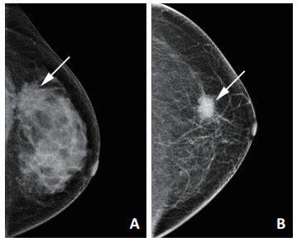
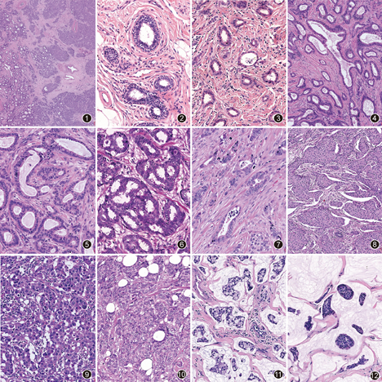
Limitations of Current Early BC Diagnosis
Imaging Techniques - Dense breast tissue can obscure small lesions, leading to an increased rate of missed diagnoses - Imaging techniques are expensive - Radiation Exposure
Pathology - Difficulties in Obtaining Tissue Samples - Subjectivity of Diagnostic Criteria - High Technical Barriers

Slide 5
But There is Another Way: By Detecting VOCs
Cells release specific biomarkers into the bloodstream during growth. Through respiration, volatile organic compounds (VOCs) within these biomarkers evaporate from the blood into exhaled breath.
Under pathological conditions, the body produces additional volatile organic compounds.
For instance, lung cancer patients exhibit unique VOCs in their breath, including acetone, methyl ethyl ketone, n-propanol, and styrene. Similarly, cirrhosis is associated with elevated thiols and fatty acids while uremia is linked to dimethyl and trimethylamine in exhaled breath .
Notes:
Hwa H-L, Kuo W-H, Chang L-Y, et al. Prediction of breast cancer and lymph node metastatic status with tumour markers using logistic regression models. J Eval Clin Pract 2008;14:275-80.

Slide 6
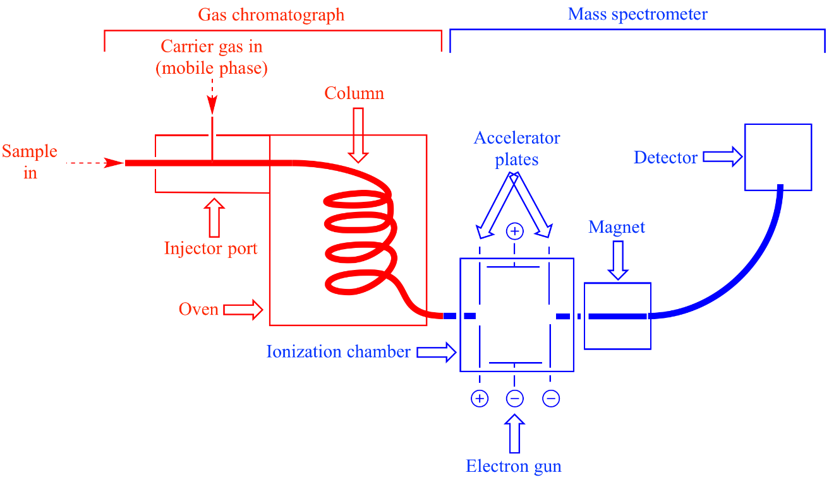
A Powerful Way for VOC-Detection: GC-MS
GC-MS (gas chromatography-mass spectrometry,气相色谱-质谱法) is a comprehensive and powerful method to detect VOC.
It is one of the gold standard methods for detecting VOCs.
It combines the high separation capability of gas chromatography with the high sensitivity and selectivity of mass spectrometry, enabling qualitative and quantitative analysis of VOCs in complex samples.

Slide 7
Yet GC-MS Is Costly
Complex sample pretreatment is required to remove interfering substances and extract target compounds. This not only increases the analysis time, but may also introduce human errors.
The Prices of GC-MS equipment :$10,000 ~ $1,000,00, and the maintenance is also expensive.
It usually requires several minutes to analyze the sample and obtain the output.

Slide 8
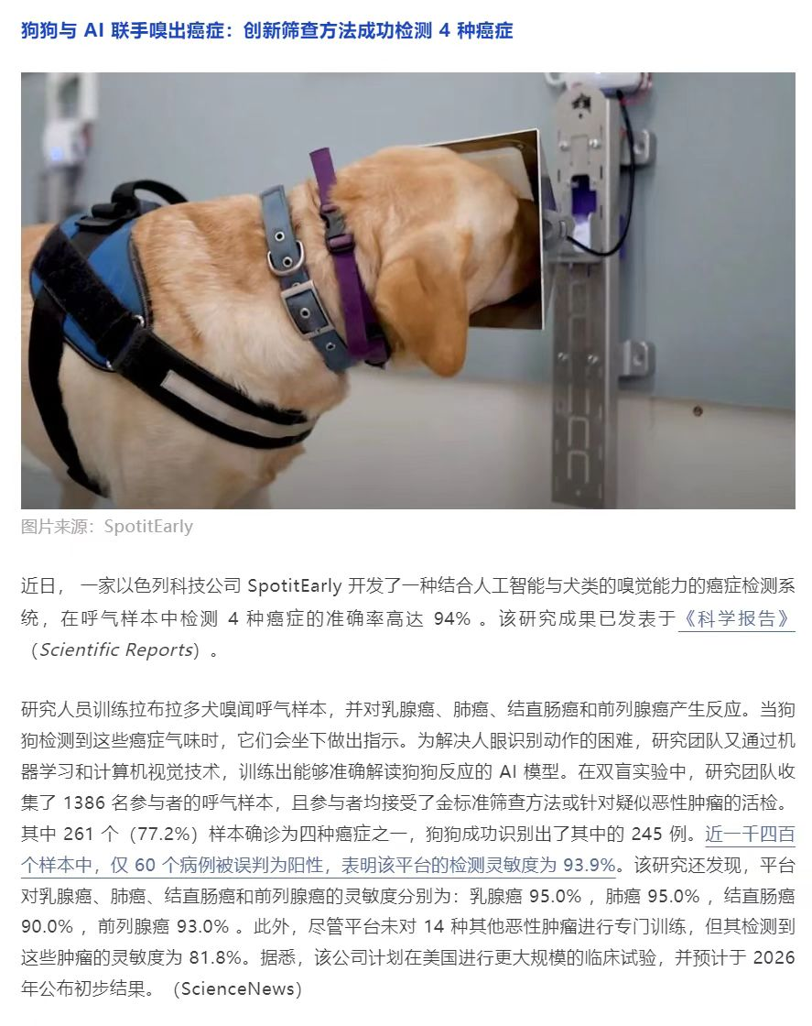
Another Feasible Approach: Biosensors with OBPs
The detection of these VOC requires specialized instruments such as GC-MS, which have significant limitations in certain complex usage scenarios (e.g., town-level health checkups, home-based detection).
Traditional sensors, such as electronic noses, are based on inorganic materials, which exhibit poor binding affinity and specificity for VOCs.
A piece of scientific news caught our attention: an Israeli tech company has developed a cancer detection system that combines AI with the olfactory abilities of dogs, with the results published in Scientific Reports.
This brings us to the idea of using OBPs as biosensors, offering promising feasibility for more accurate cancer prediction.

Slide 9
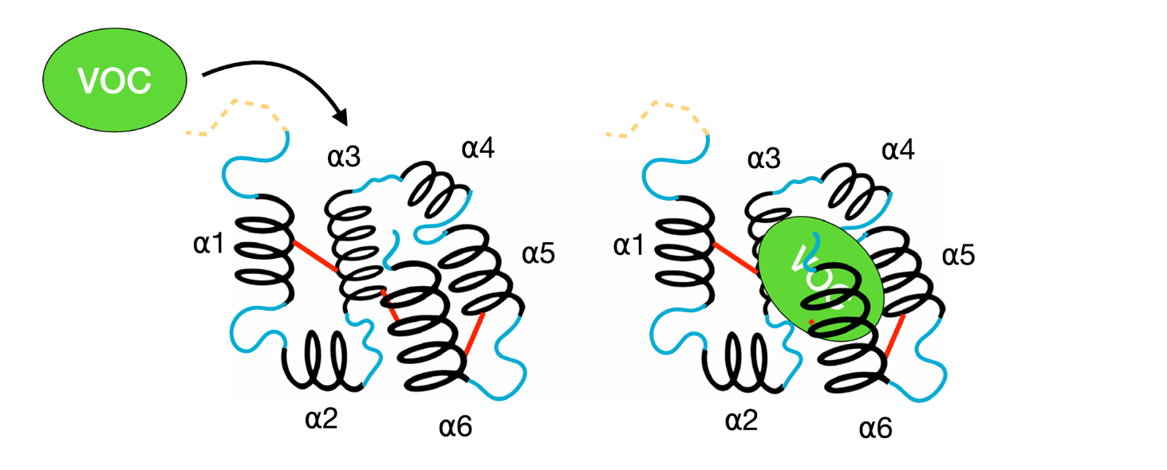
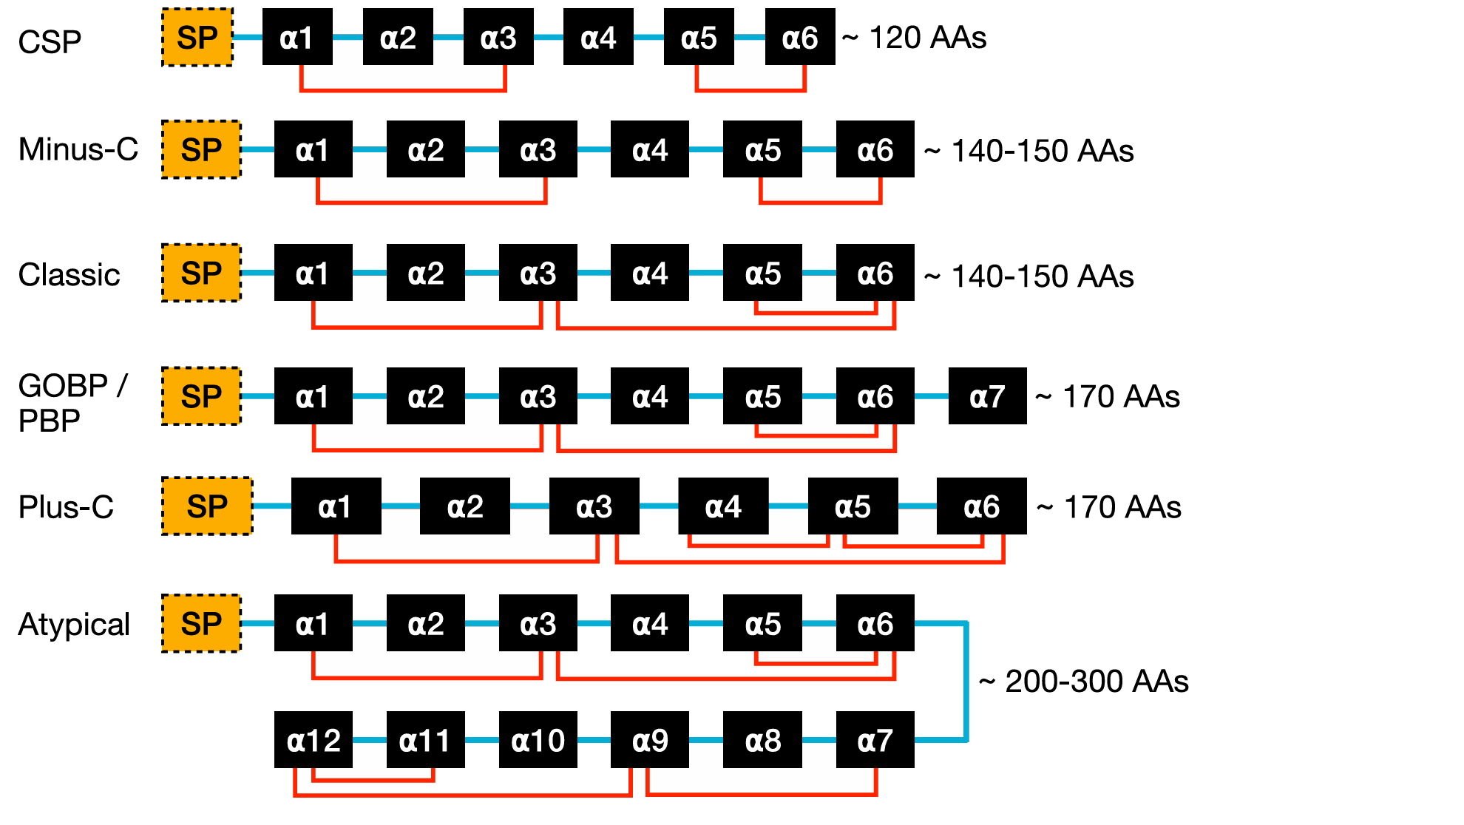
So, What Are OBPs?
Odorant binding proteins (OBPs) are a diverse family of small, 10–20 kDa, soluble extracellular target-binding .
Since their initial discovery in insects’ sensillum lymph in 1981, thousands of new OBPs have been identified and isolated through genome sequencing and molecular biology approaches.
OBPs are thought to act as odor transporters, solubilizing VOCs and pheromones from the surrounding air into the aqueous phase of the odor-sensory organ, such as the mucus in the nose or sensillum lymph of an antennae.
Notes:
Ref: https://www.nature.com/articles/s41597-023-02195-y

Slide 10
Features of OBPs
Structure:
Small globular proteins: Typically 10-30 kDa in size.
Central hydrophobic cavity: Provides a binding site for odorant molecules through various interactions (hydrophobic, polar, electrostatic, π-stacking).
Diverse binding properties: Can bind a wide range of odorant molecules (especially aromatic, aliphatic).
Properties:
High stability: Resistant to wide pH and temperature ranges.
Easy to isolate and purify: Facilitates their use in biosensor development.
Notes:
Ref: https://doi.org/10.1039/D2SD00112H

Slide 11
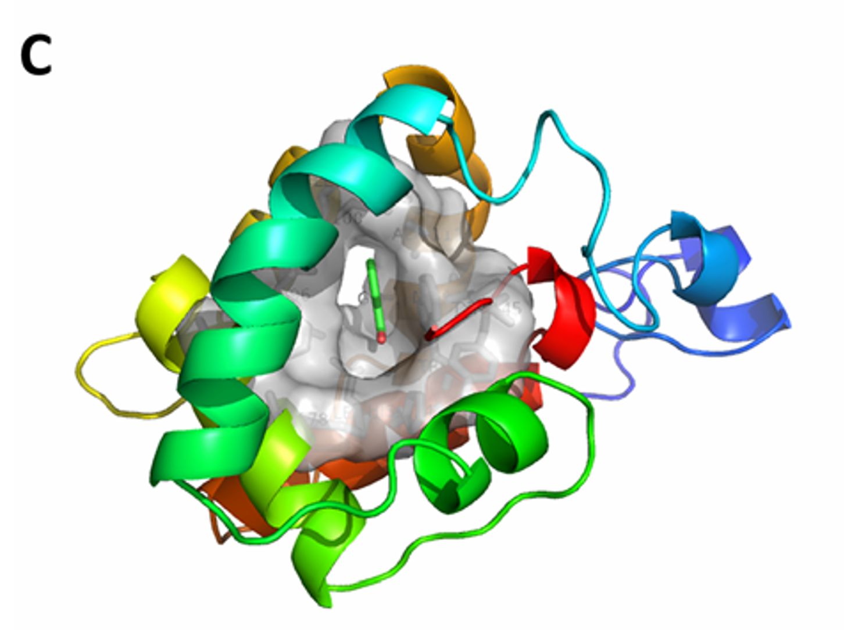
Structure of OBPs of oriental fruit fly (Bactrocera dorsalis) and the binding mode of an OBP-isoamyl acetate (异戊酸乙酸酯) complex.
Notes:
Ref: https://doi.org/10.1039/D2SD00112H

Slide 12
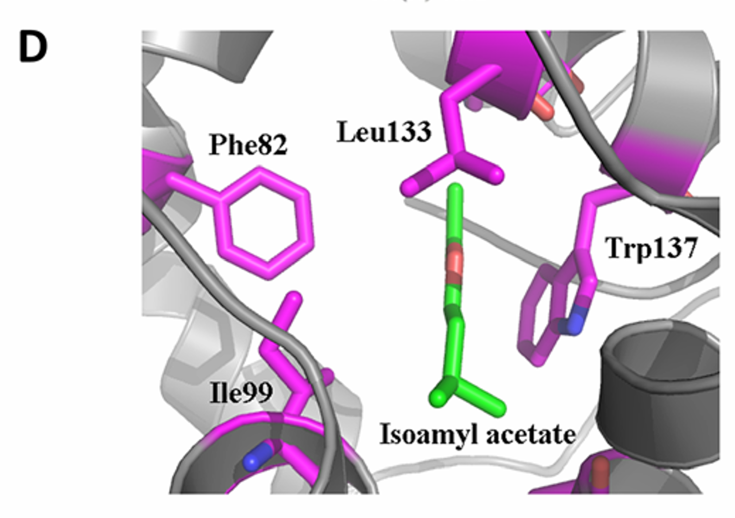
Isoamyl acetate in the binding pocket of OBPs.
Notes:
Ref: https://doi.org/10.1039/D2SD00112H

Slide 13
OBPs v.s. ORs
Features | OBPs | ORs
Robustness | Higher, Easier to Expressed & Purified | Relatively Lower, Harder to Expressed & Purified
Seletivity | Lower | Higer
Sensitivity | High | High
Cost | Lower | Higer
Application | Odor detection, food safety, and environmental monitoring. | High-sensitivity and high-selectivity odor detection
*Olfactory receptors (ORs) are a special class of proteins to convert odor molecules in the air into nerve signals, transmitting them to the brain, and ultimately forming our sense of smell, while OBPs are the proteins to submit odor molecules to ORs.
Notes:
Ref: https://www.nature.com/articles/s41597-023-02195-y

Slide 14
OBPs v.s. Chemical Approach
Features | OBPs | Chemical (such as gas sensors, surface acoustic wave sensors)
Selectivity | Higher | Lower
Sensitivity | Higher | Lower
Operation Competitivity | Lower | Higher
Cost | Medium | Lower
On VOCs | Better | Worse

Slide 15
Aim: To design OBPs capable of detecting VOCs related to BC
Oxidative stress in breast cancer cells can induce lipid peroxidation, producing a large amount of aldehydes such as hexanal , heptanal, octanal, and nonanal which are unique metabolic products of breast cancer cells and can be detected by breath analysis, promising to be new biomarkers for breast cancer diagnosis.
Our target: Design 3 new kinds of OBPs which could respectively dock with hexanal, octanal, and nonanal. And the docking performance (robustness, affinity, selectivity) should in principle exceeds natural OBP categories.
Notes:
KasapovicJ, Pejic S, Todorovic A, Stojiljkovic V, Pajovic SB. Antioxidant status and lipid peroxidation in the blood of breast cancer patients of different ages. Cell Biochem Funct 2008;26:723-30.
Mense SM, Remotti F, Bhan A, et al. Estrogen-induced breast cancer: alterations in breast morphology and oxidative stress as a function of estrogen exposure. Toxicol Appl Pharmacol 2008;232:78-85.
Ambrosone CB. Oxidants and antioxidants in breast cancer. Antioxid Redox Signal 2000;2:903-17.
Returner H, Kessler W, Einsele H, et al. Ethanol promotes oxygen-radical attack on proteins, but not on lipids. Drug Metab Rev 1989;20:219-32.
Jie Li，Yulan Peng，Yong Liuc, Wen wen, et al. Investigation of potential breath biomarkers for the early diagnosis of 2 breast cancer using gas chromatography–mass spectrometry. Clinica Chimica Acta 2014

Slide 16
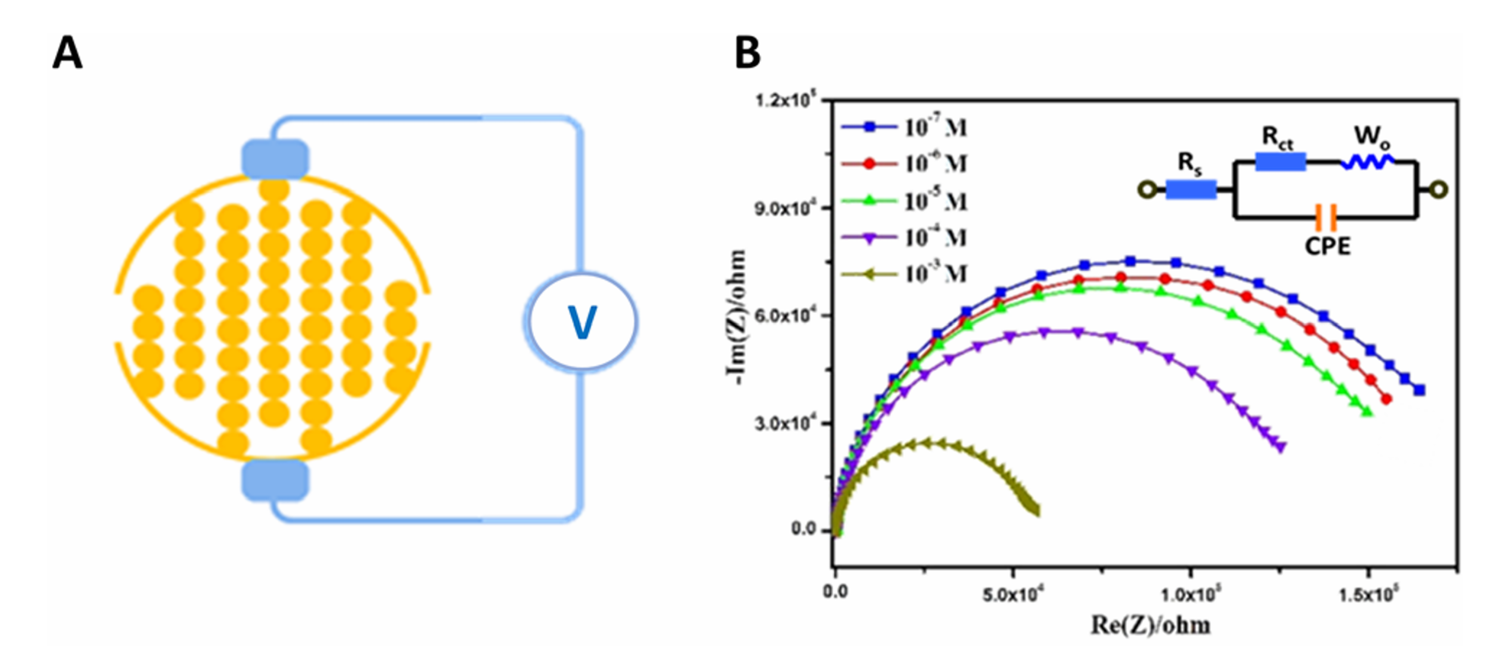
*How Can OBP Be mounted on Odorant Biosensors
OBP-based biosensors with electrochemical techniques
With increasing concentration of isoamyl acetate, charge transfer resistance (Rct) gradually decreased. This indicated a recovery in the efficiency of the mass transfer phenomenon related to the dielectric and conductive properties of the sensing membrane on the electrodes.
Notes:
Ref: https://doi.org/10.1039/D2SD00112H

Slide 17
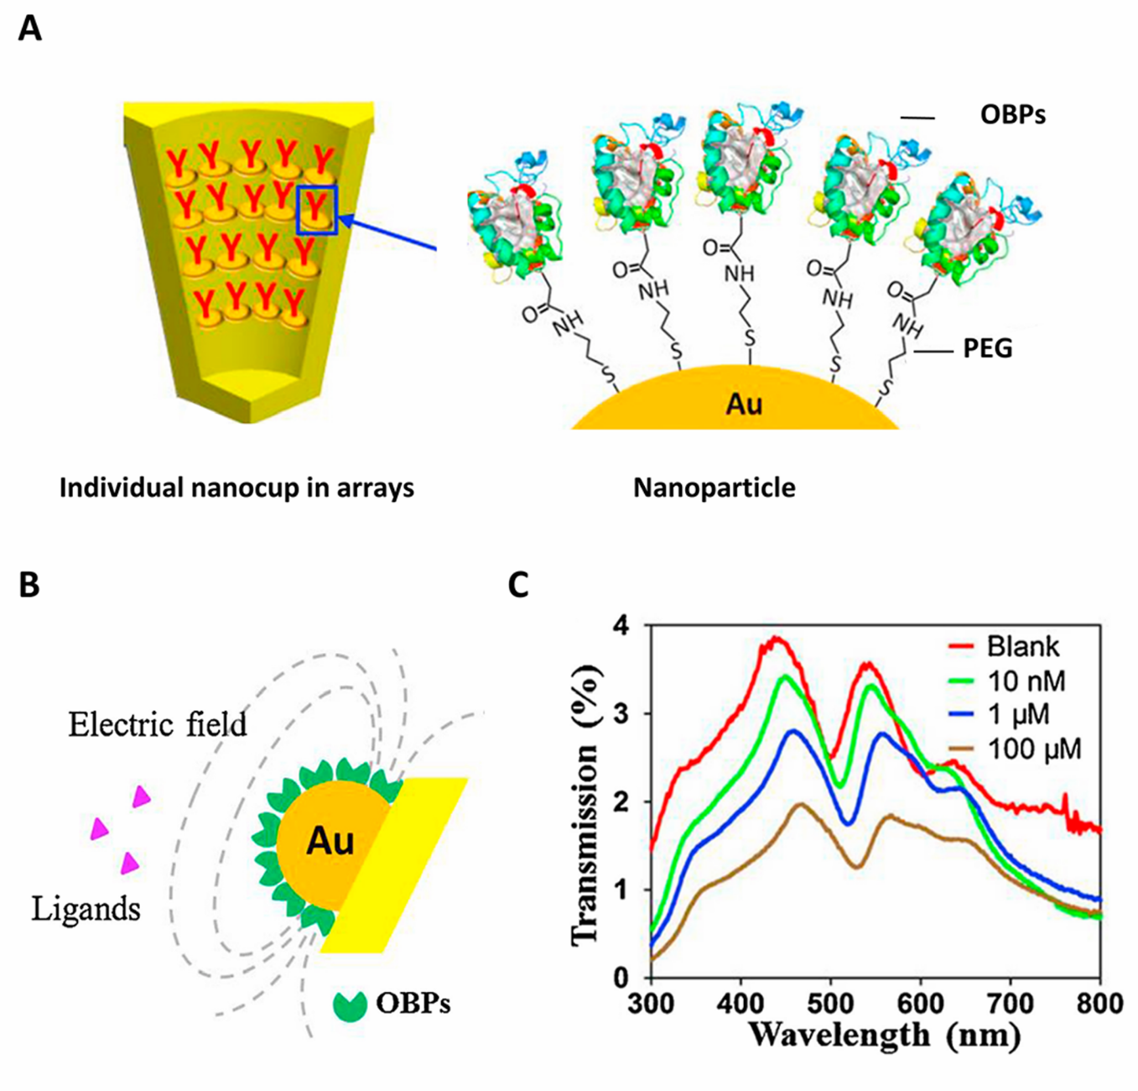
*How Can OBP Be mounted on Odorant Biosensors
OBP-based biosensors with optical technology
This is a label-free method.
When visible light stimulates nanoscale structures, the effects of surface plasmon resonance (表面等离子体共振) turned into nonpropagating or propagating within the limited volume on the device surface, which is named localized surface plasmon resonance(局部等离子体共振).
Notes:
Ref: https://doi.org/10.1039/D2SD00112H

Slide 18
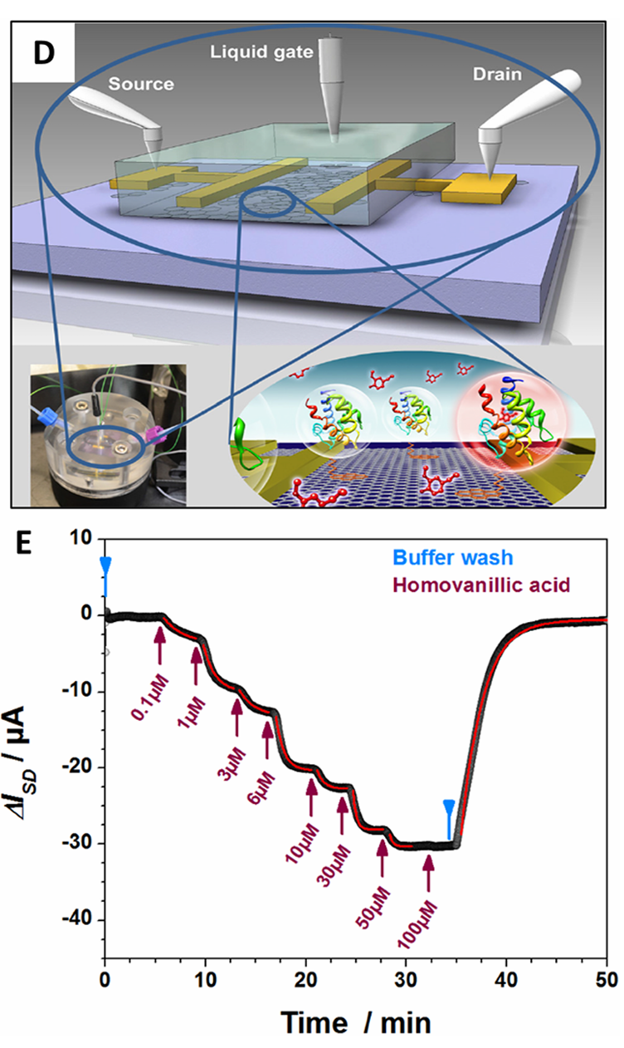
*How Can OBP Be mounted on Odorant Biosensors
OBP-based biosensors with field-effect transistors
The charges induced by interactions between olfactory proteins and target analytes can influence the grid voltage and subsequently cause changes in the source–drain current measured in the test.
It has high sensitivity.
Taking 1-pyrenebutanoic acid succinimidyl ester as the linker, the odorant binding protein (OBP14) from the honeybee, Apis mellifera, was modified on the reduced graphene oxide covered base substrate. Obvious variations in source–drain current response were observed when detecting a proved ligand, homovanillic acid, of different concentrations
Notes:
Ref: https://doi.org/10.1039/D2SD00112H

Slide 19
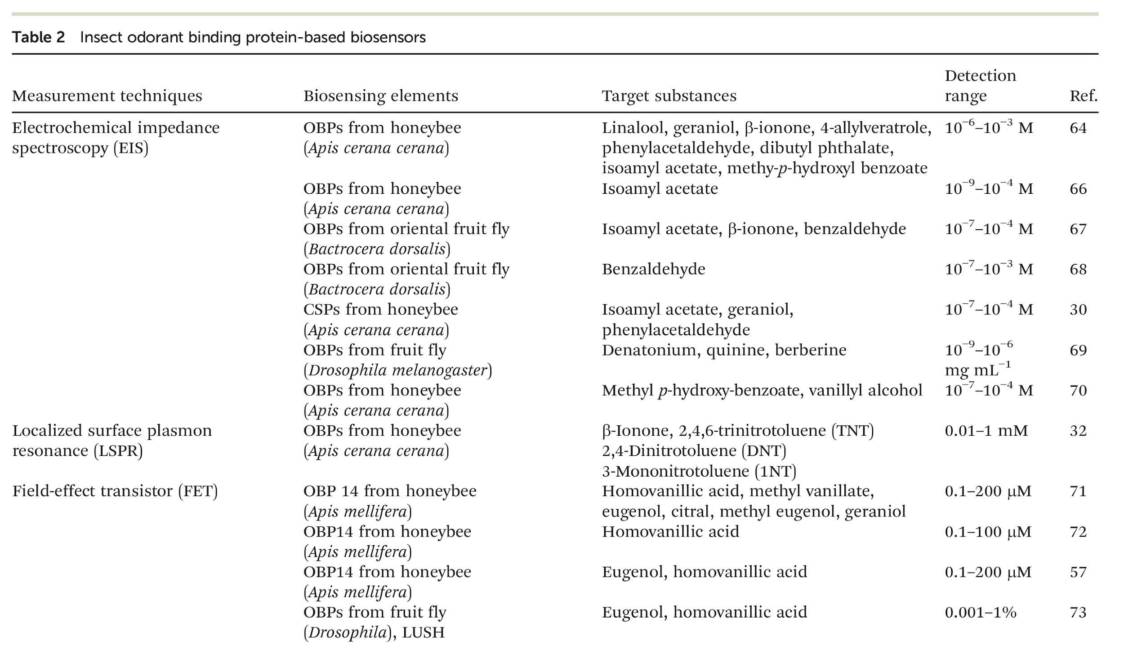
*How Can OBP Be mounted on Odorant Biosensors
Notes:
Ref: https://doi.org/10.1039/D2SD00112H

Slide 20
Methodology & Results

Slide 21
Methodology & Results
OBP Selecting
RFdiffusionAA for Backbone Design
LigandMPNN design of protein seqeunces
Analysis of generated sequences
-PyRosetta Score Function
-Affinity comparison with AutoDock
-Refolding with ESMFold

Slide 22
OBP-Selecting
To generate the Protein for VOC Recognition, we download the pdb of all possible OBP. We have also written a Python script to analyze the binding affinities of various compounds to different OBP and identify the best one for specified target molecules based on a new scoring method. After that, we successfully found the best OBP to detect Hexanal, Octanal, Nonanal respectively.
We also combine the two structures (OBP and its corresponding VOC) by simple concatenation. Then we got our OBP with ligands: BminOBP9_S24P_lig.pdb, SaveOBP9_lig.pdb, AgamCSP3_lig.pdb

Slide 23
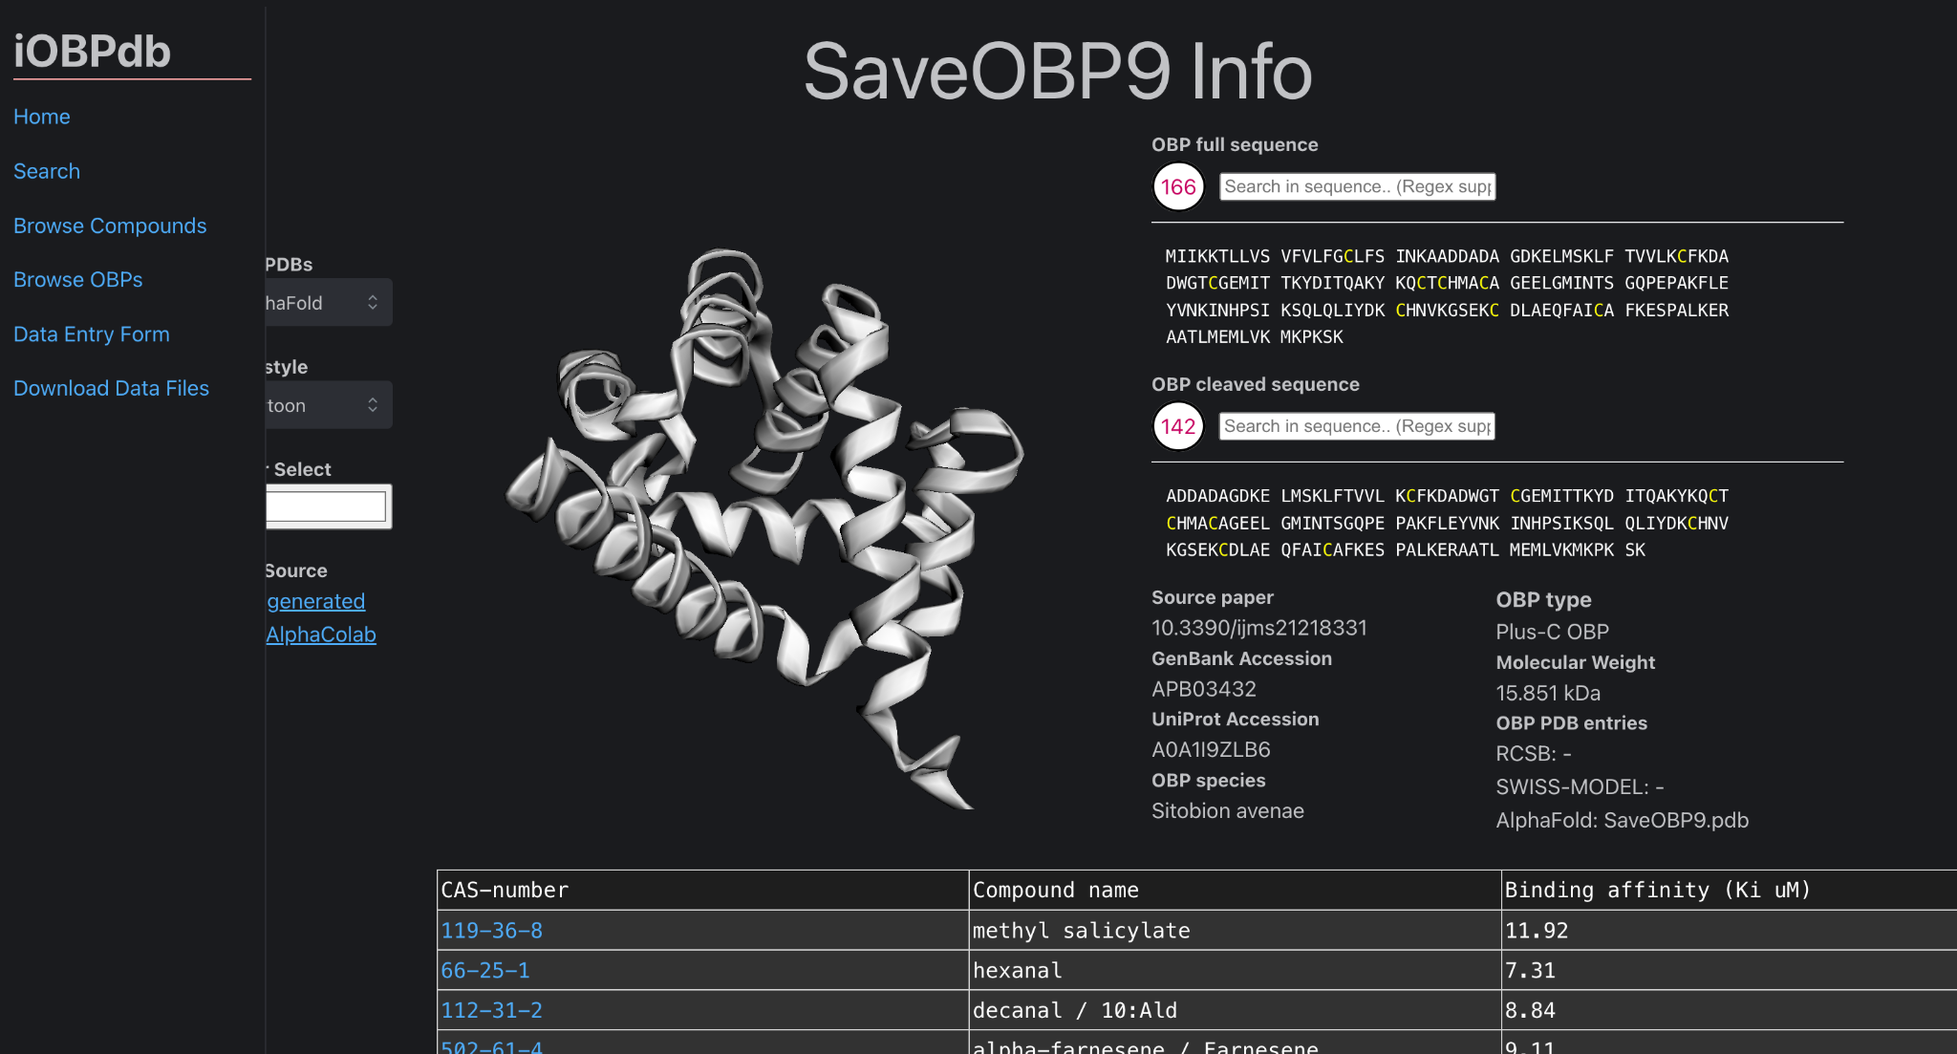

Slide 24
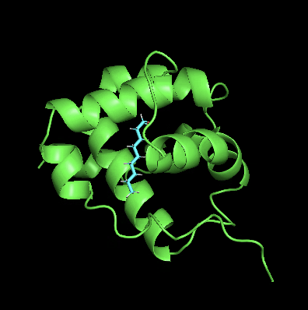
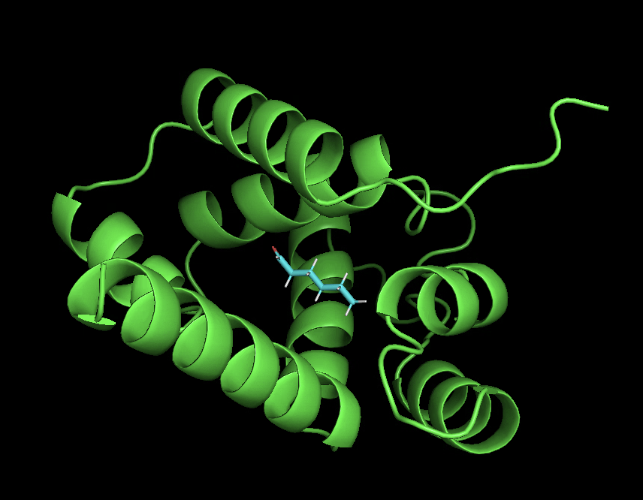
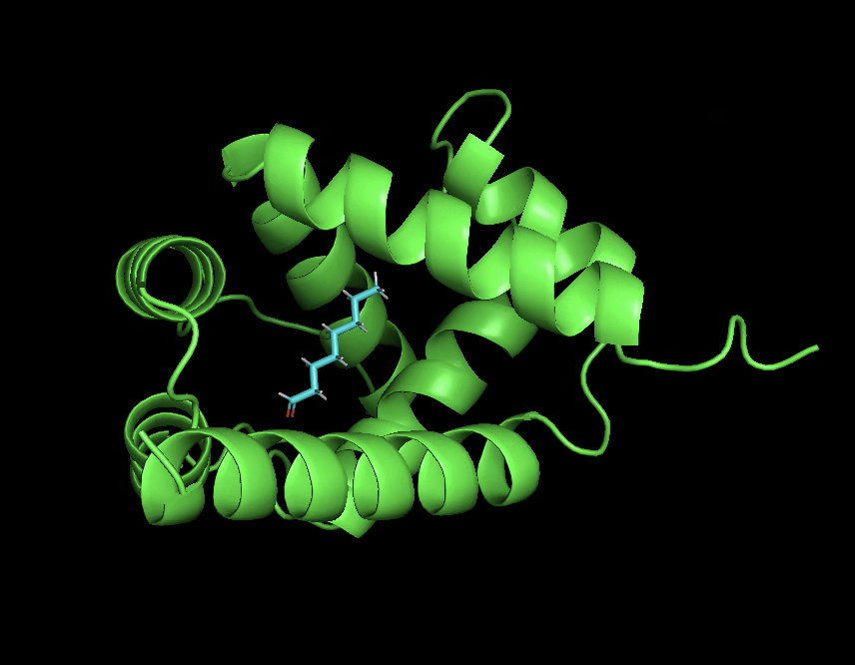
SaveOBP9_lig
AgamCSP3_lig
BminOBP9_S24P_lig

Slide 25
RFdiffusionAA for Backbone Design
We put all these natural OBP into training. For time reasons, we’re only generating 15 output structures (inference.num_designs=15). Generally, you’ll want to create hundreds of different structures and then filter them for those with the properties which you desire. Also, we’re reducing the number of diffusion timesteps taken (diffuser.T=100).
Here is an example of running the backbone of Hexanal:
~/apptainer/x86_64/bin/apptainer run --nv rf_se3_diffusion.sif -u run_inference.py inference.deterministic=True diffuser.T=100 inference.output_prefix=output/hexanal/sample
inference.input_pdb=input/BminOBP9_S24P_lig.pdb contigmap.contigs=[\'120-140\'] inference.ligand=UNK
inference.num_designs=15 inference.design_startnum=0

Slide 26
Analysis of generated backbones.
While RFdiffusionAA attempts to come up with biologically relevant backbone conformations, the particular backbones it comes up with do not always accord with what you are interested in.
All the filters at this stage of the pipeline should be ones which are based on the backbone only. Note that often times the best filtering approach is a manual one – simply open up the structures in a viewing program like PyMol and use your biochemical knowledge about the system to determine which structures have the possibility to work, and which are obviously silly.
After picking the possible backbone, now we have a possible one for each VOC. We will further design the protein sequence using LigandMPNN.

Slide 27
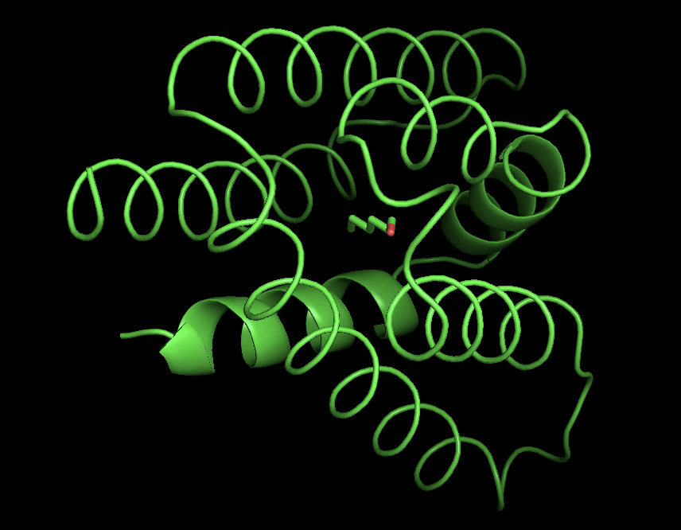

Slide 28
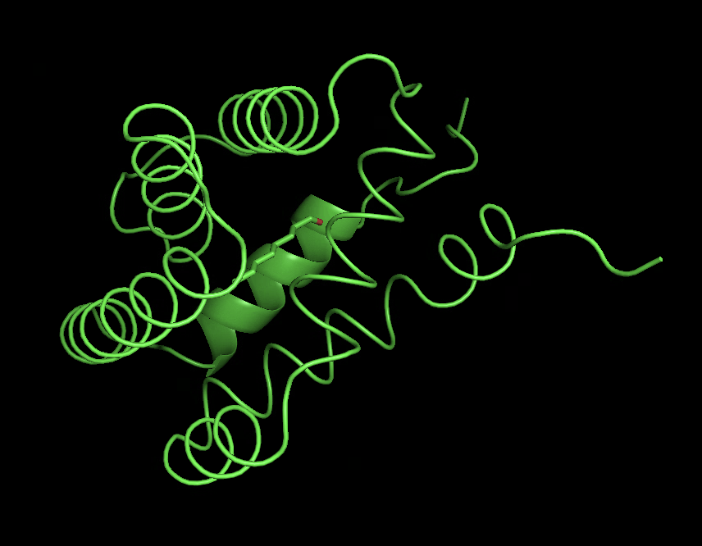

Slide 29
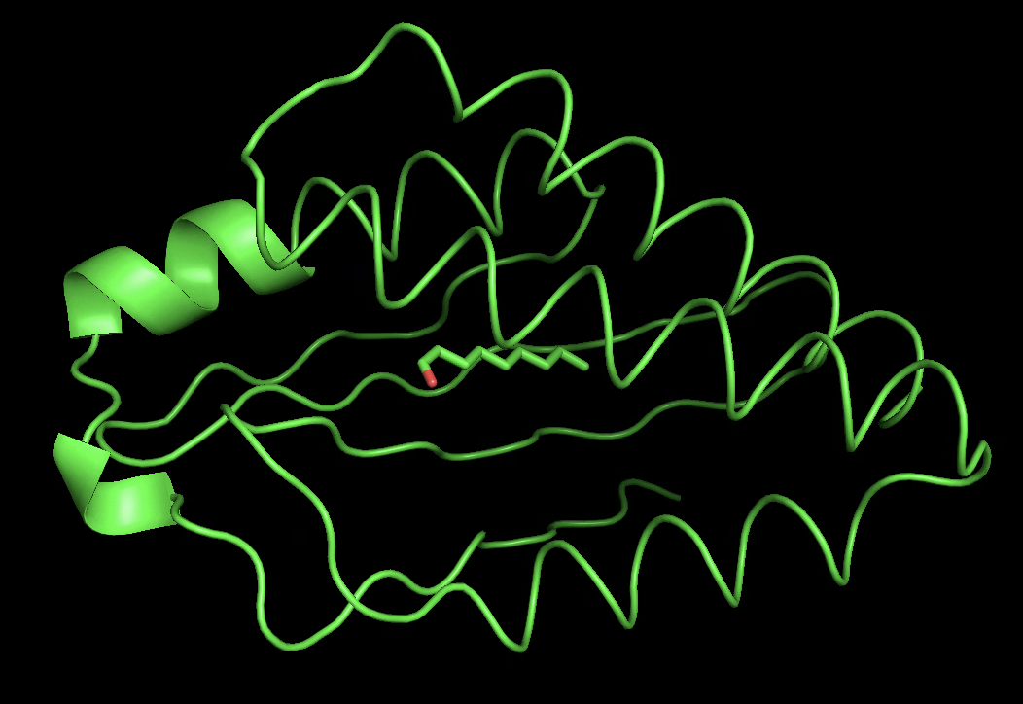
Residue sequence design with LigandMPNN

Slide 30
LigandMPNN design of protein seqeunces
Like regular RFdiffusion, RFdiffusionAA only creates backbone structures, with the added residues represented in the output structure as glycine. Before using these results, sequences need to be generated.
We’ll be using LigandMPNN to assign amino acid identities to the generated residues. Giving Nonanal as an example:
conda activate ligandmpnn_env
python run.py \
--checkpoint_ligand_mpnn ./LigandMPNN/model_params/ligandmpnn_v_32_010_25.pt \
--checkpoint_path_sc ./LigandMPNN/model_params/ligandmpnn_sc_v_32_002_16.pt \
--pdb_path "./inputs/nonanal_rfaa.pdb" \
--out_folder "./outputs/nonanal" \
--model_type "ligand_mpnn" \
--number_of_batches 1 \
--batch_size 10 \
--pack_side_chains 1 \
--number_of_packs_per_design 1 \
--pack_with_ligand_context 1

Slide 31
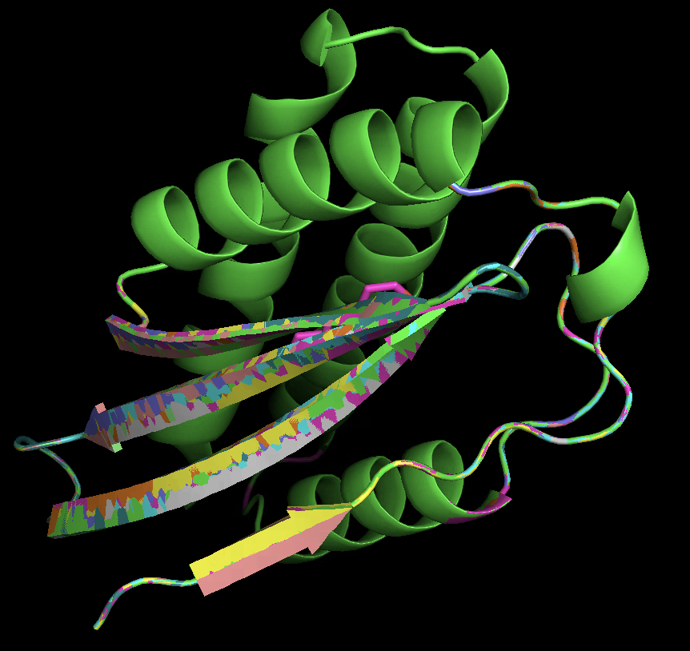
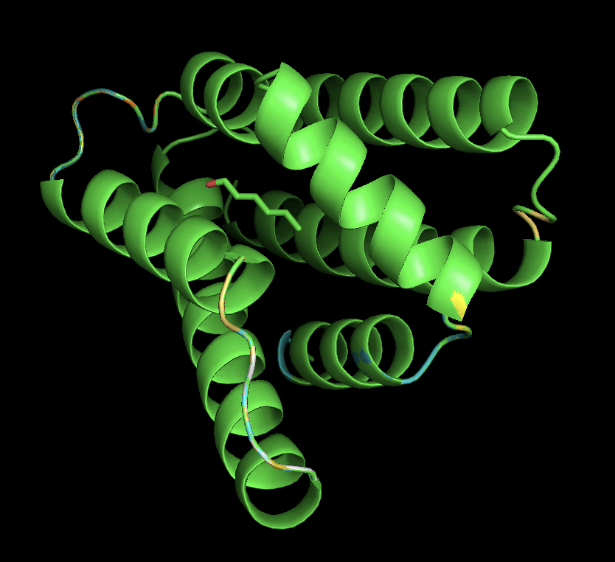
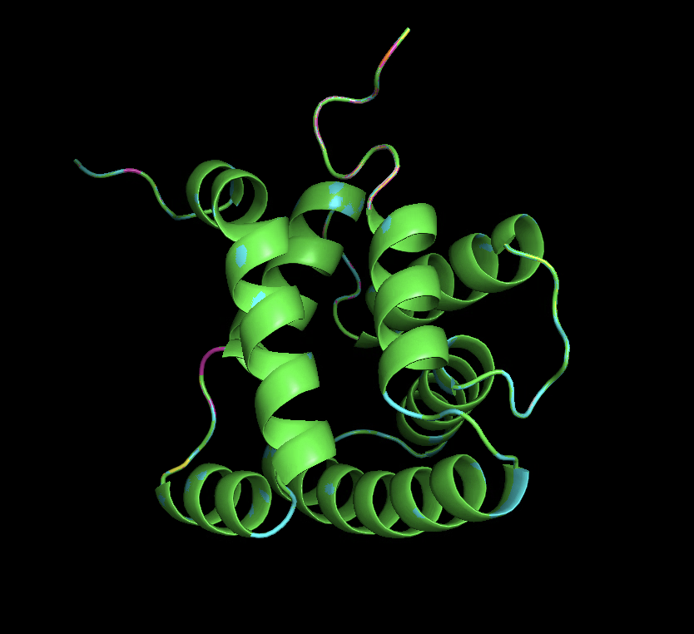

Slide 32
Analysis of generated sequences
For the generated sequences, we want it to combine the target VOC better than natural OBP does. Also, we want it to be less affinity to other VOC. So we test each sample with AutoDock and select the best generated OBP among them.
Also, we performed a Pyrosetta Scoring Function with relaxation on both natural OBP and denovo OBPs. We were glad to find that the denovo OBPs performed better both in affinity by AutoDock and stability by Pyrosetta Scoring Function.

Slide 33
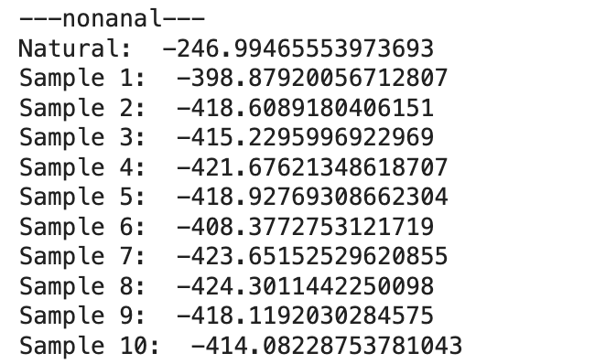
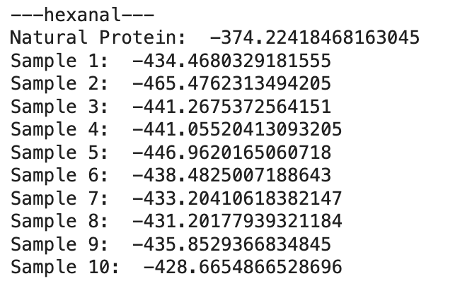
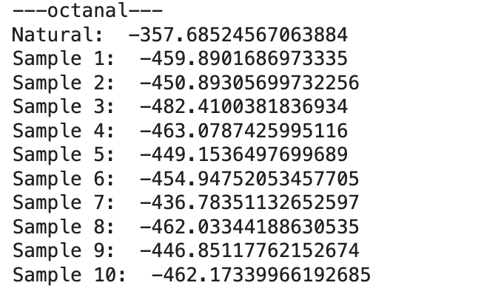
PyRosetta Results

Slide 34
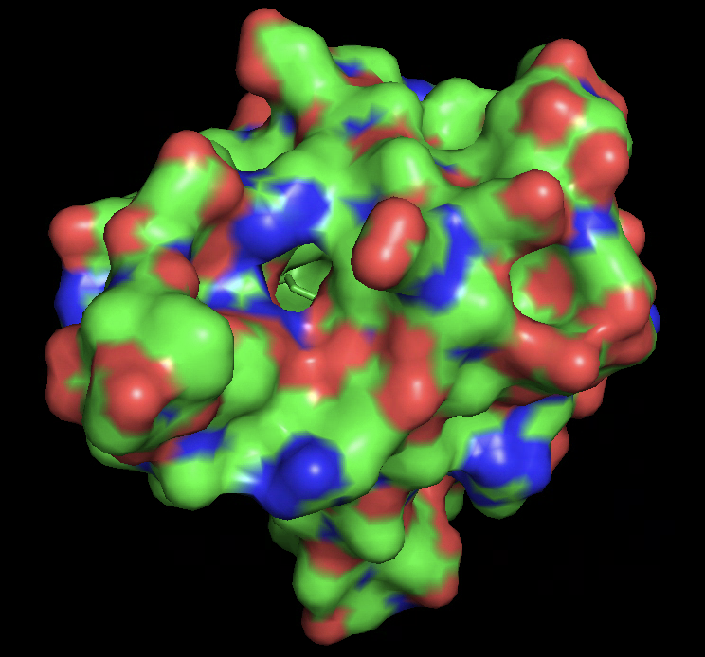
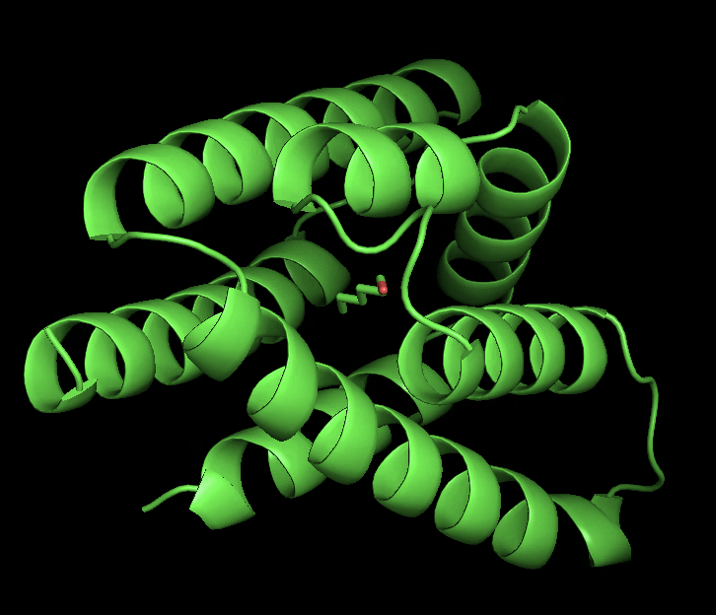
Hexanal_denovo

Slide 35
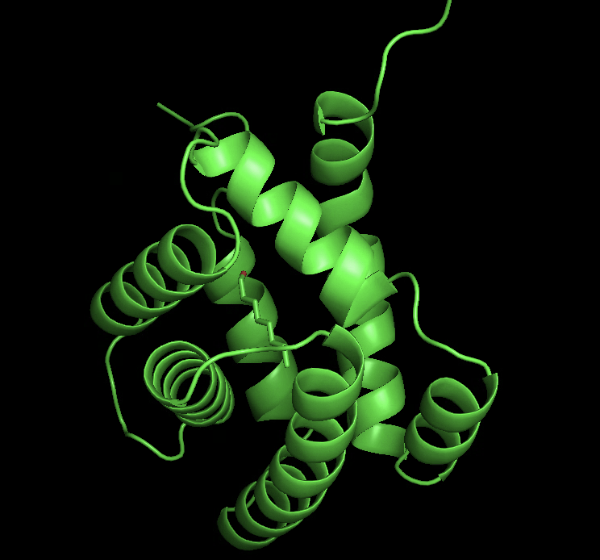
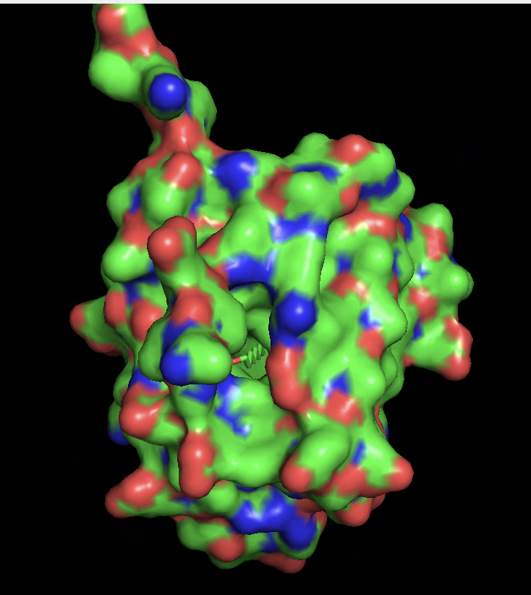
Octanal_denovo

Slide 36
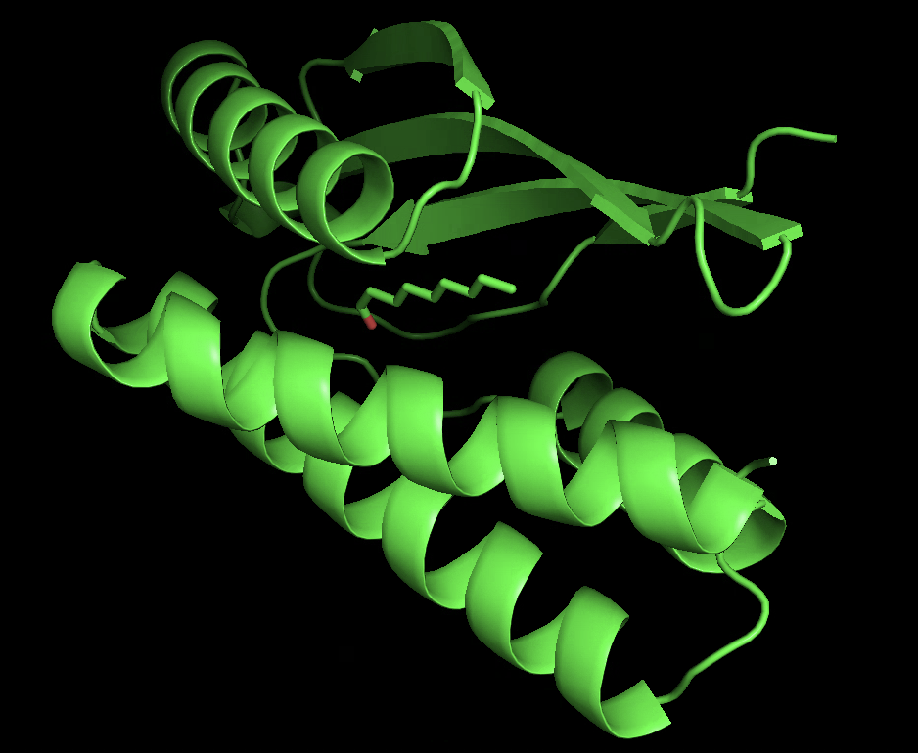
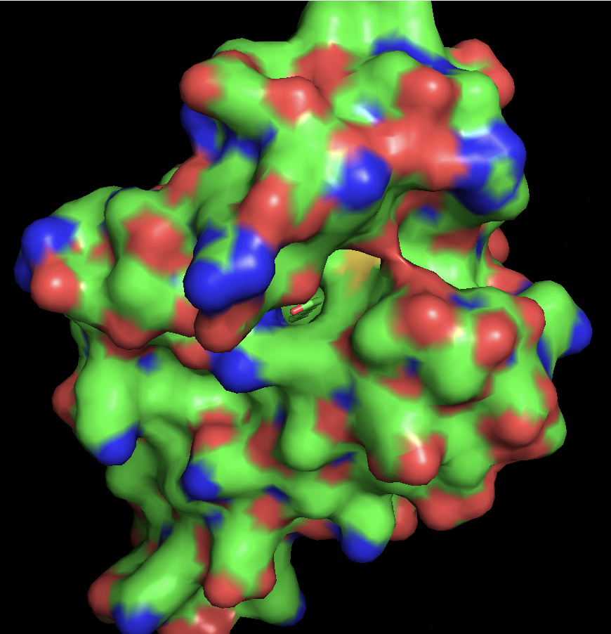
Nonanal_denovo

Slide 37
Analysis of chosen sequences - refolding
One approach which has been shown to work quite well to improve the success rate of designs is the concept of “forward folding”. That is, after using a particular structure to design a sequence, can you recapitulate the structure from that sequence? The concept is that under experimental conditions, the only information you’re providing is the input protein sequence. You’re therefore looking for designs which can robustly produce the desired structure from that sequence.
Here we use ESM Fold to refold the generated sequence.

Slide 38
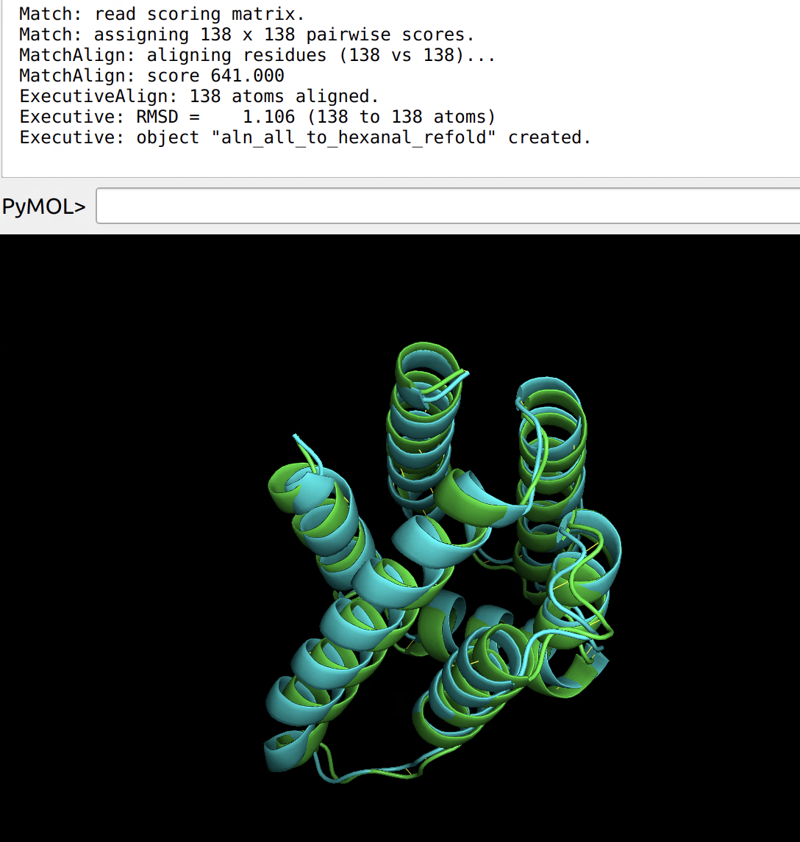

Slide 39
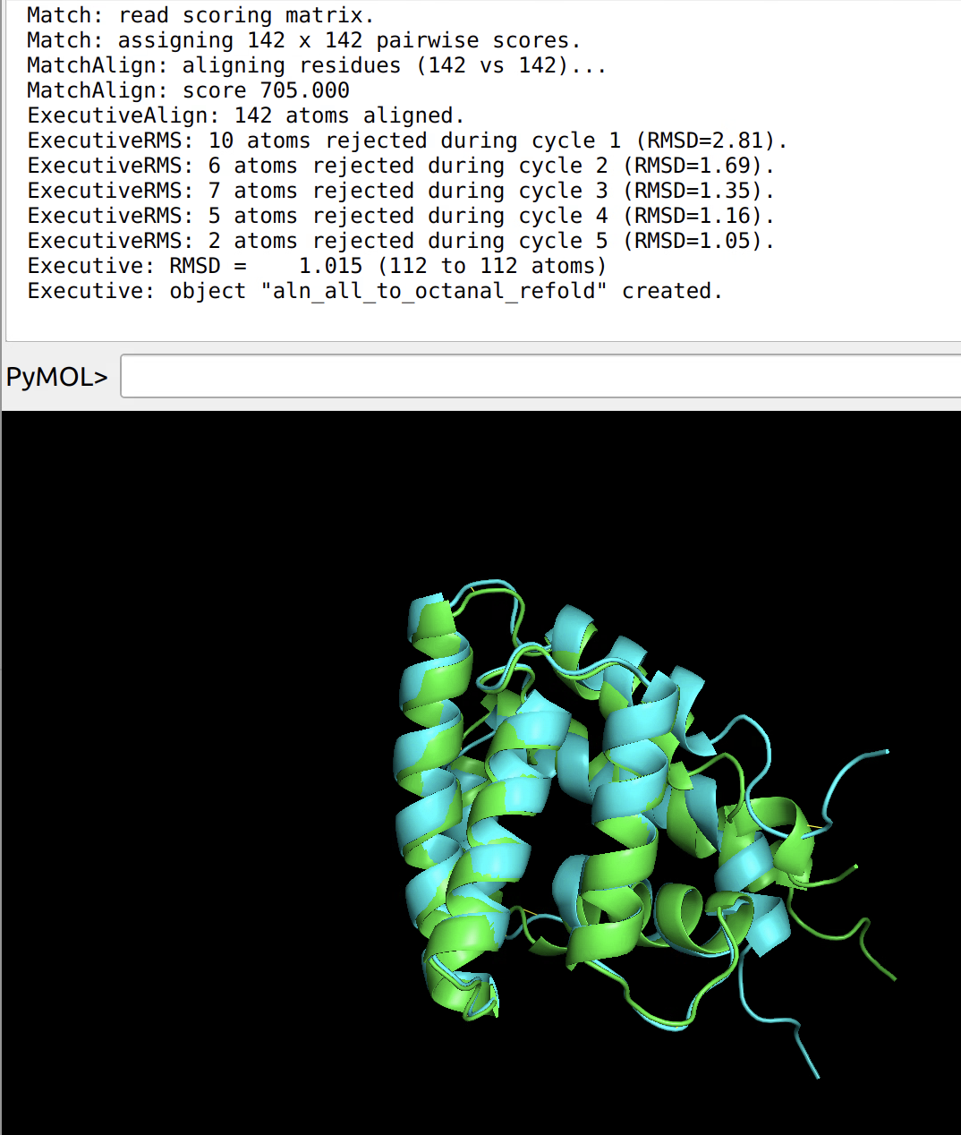
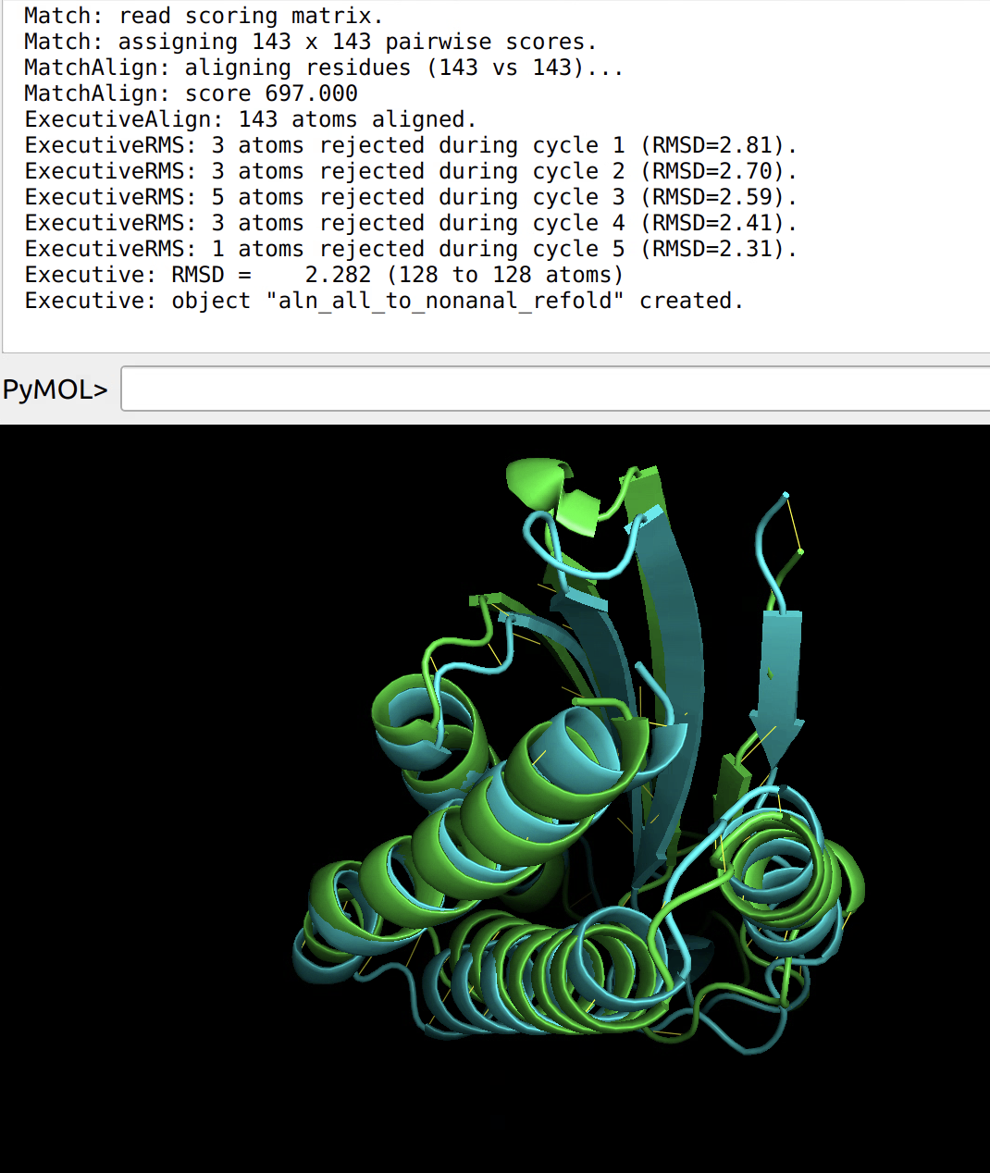

Slide 40
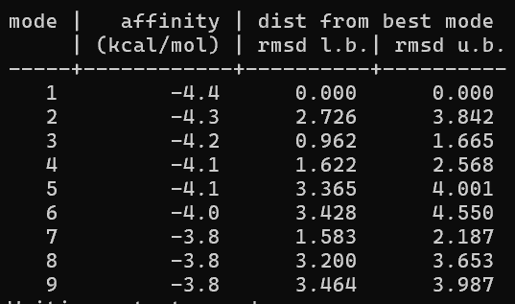
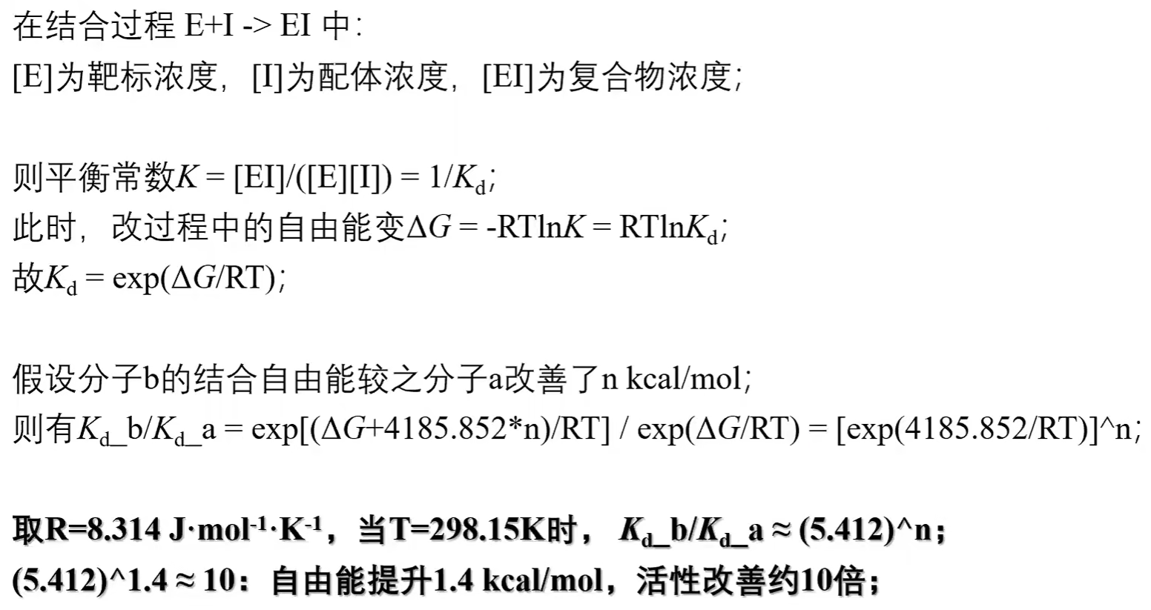
Results
Autodock Vina 半柔性对接
>-4kcal/mol: 结合作用较差
-4~-7kcal/mol: 结合作用中等
<-7kcal/mol: 结合能力较强

Slide 41
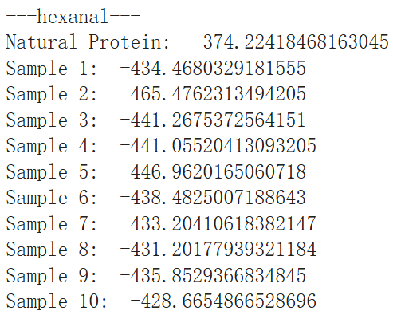
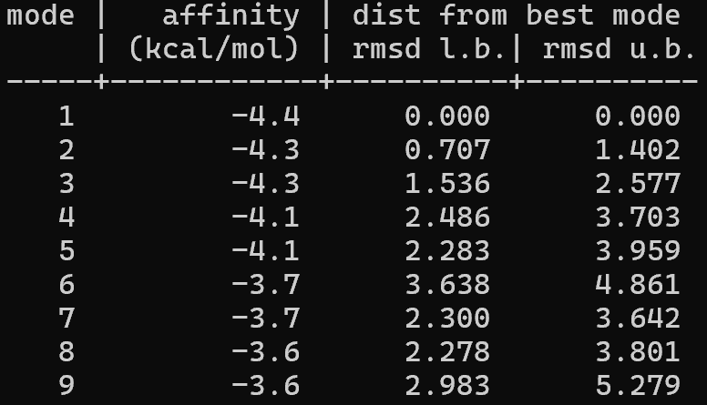
Results
BminOBP9_S24P score:-374.2
BminOBP9_S24P & hexanal
with RFdiffusionAA | Hexanal (kcal/mol) | without RFdiffusionAA | Hexanal (kcal/mol)
1 | -3.9 | 1 | -3.6
2 | -4.4 | 2 | -3.7
3 | -4.0 | 3 | -3.2
4 | -3.7 | 4 | -3.4
5 | -3.6 | 5 | -3.8
6 | -3.7 | 6 | -3.3
7 | -3.6 | 7 | -3.8
8 | -4.2 | 8 | -3.4
9 | -3.7 | 9 | -3.2
10 | -3.9 | 10 | -3.6
BminOBP9_S24P | -4.4 | BminOBP9_S24P | -4.4
2 score:-465.5

Slide 42
Results
Screening Rules:
Affinity for target VOC better than nature OBP
Affinity for off target VOC weaker than nature OBP
Higher stability
SaveOBP9 & Octanal (kcal/mol)
AgamCSP3_nonanal (kcal/mol)

Slide 43
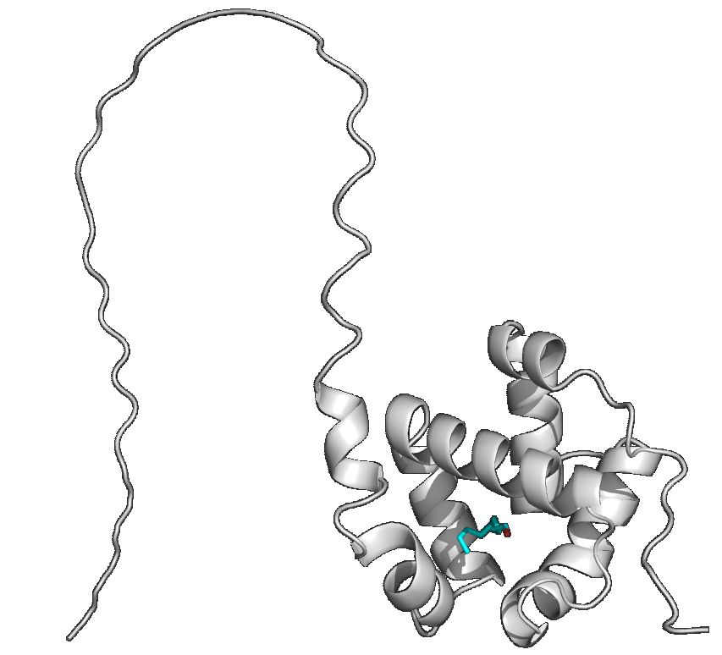
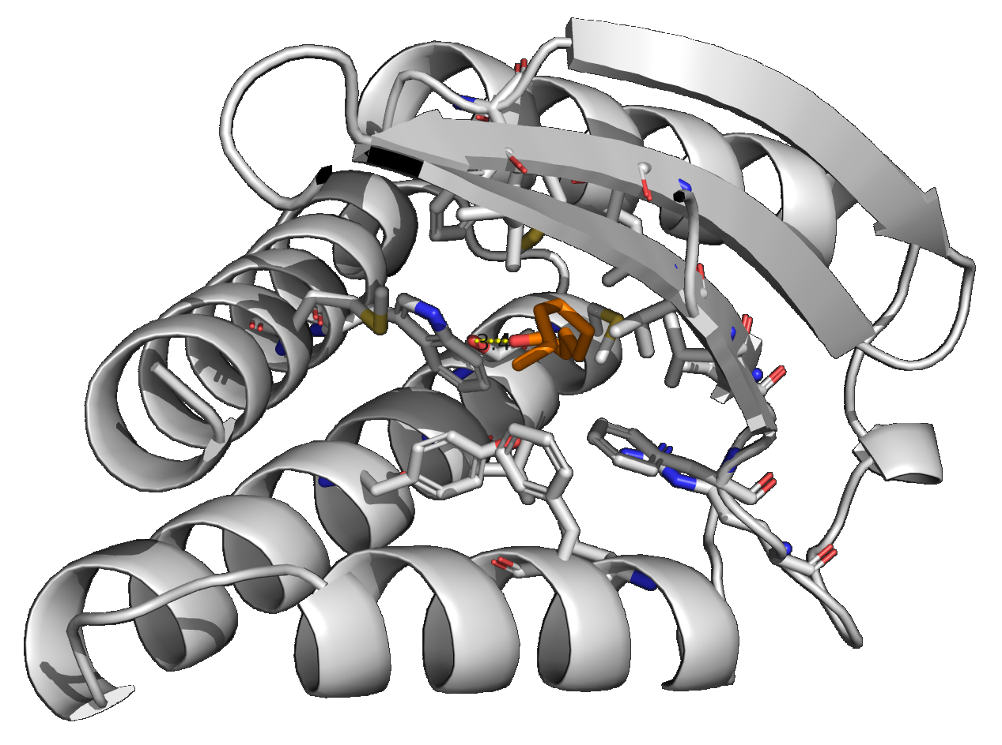
Results
Analysis
Nature & Design
AgamCSP3
Sample 6

Slide 44
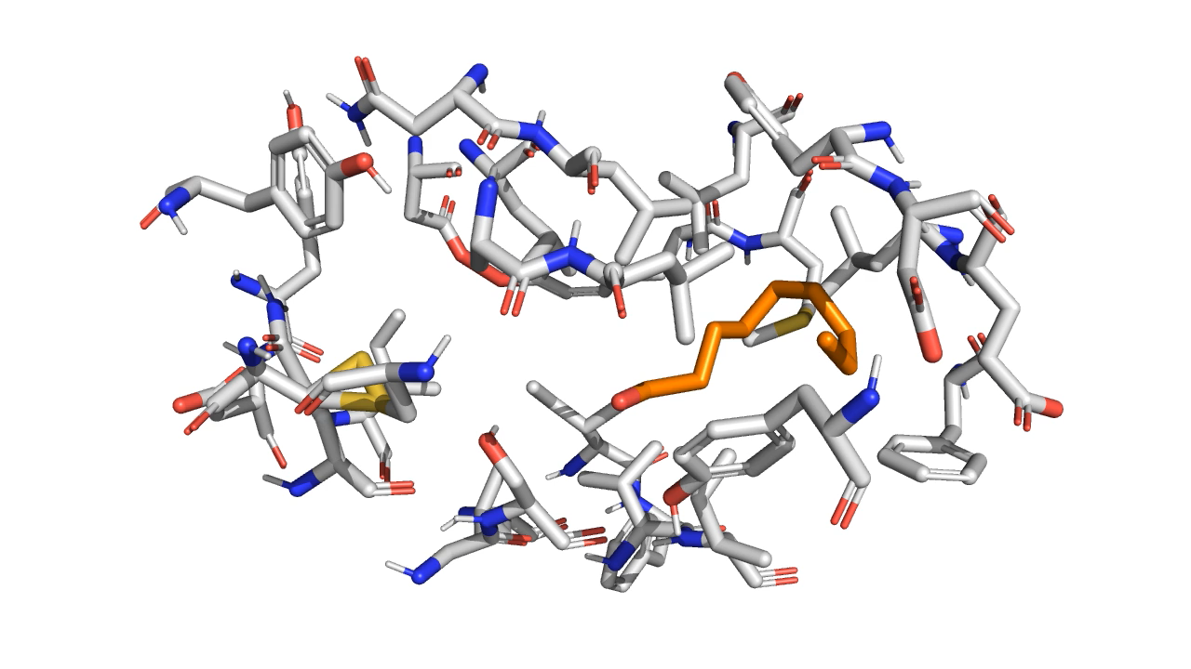
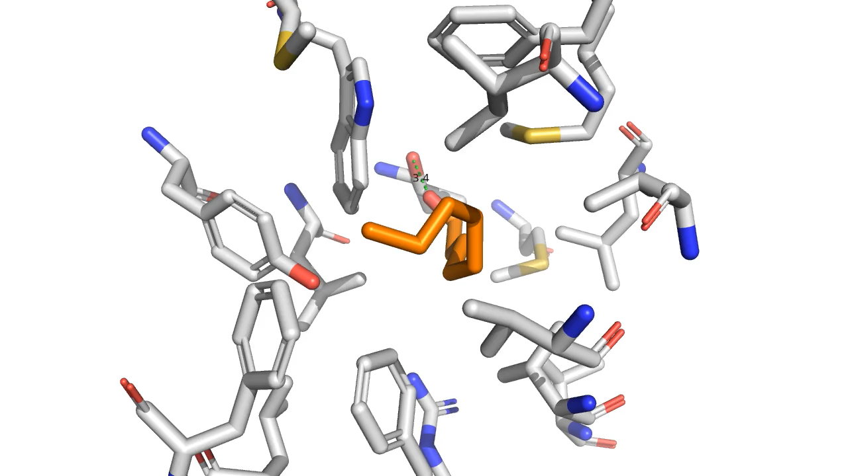
Results
Analysis
Nature & Design
AgamCSP3
Sample 6

Slide 45
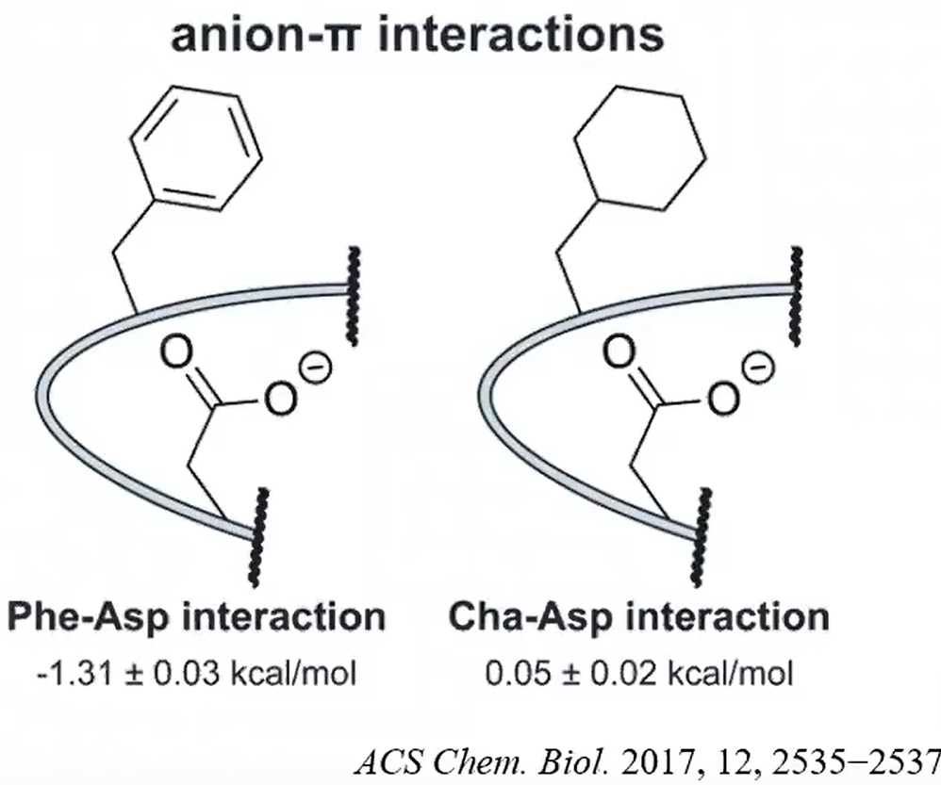
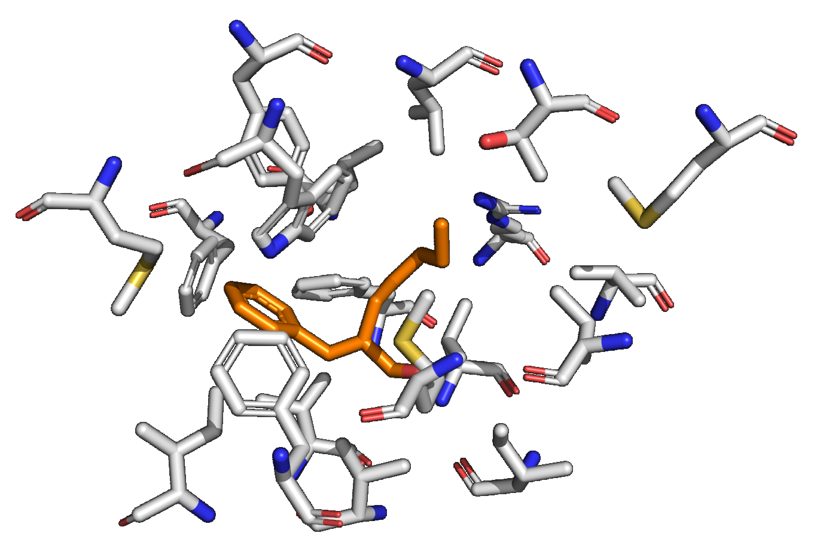
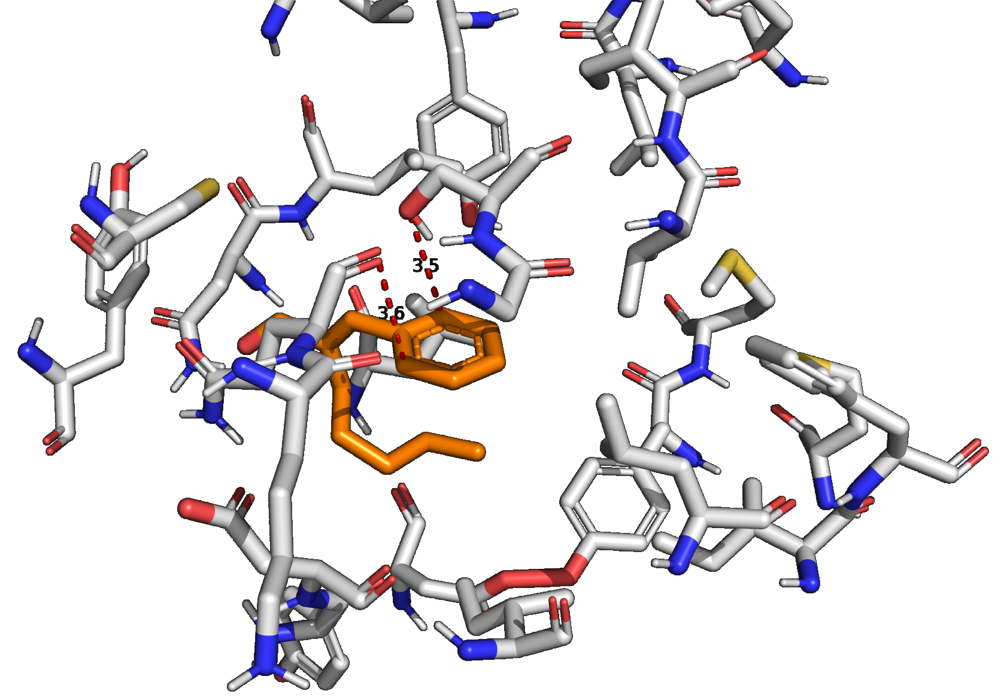
Results
Analysis
Off target：Pentyl cinnamaldehyde
Sample 6
AgamCSP3

Slide 46
Contribution
熊闻野：Background Investigation, Natural OBP Selecting, RFdiffusion_aa Backbone Design, LigandMPNN Sequence Design, ESMFold refolding, PyRosetta Score Function, PPT making
张家睿: Background Investigation, Natural OBP Selecting, autodock vina, Schrodinger, pymol, docking cartoon making, interaction analysis, PPT making
邵睿：Background Investigation, PyRosetta Score Function,
PPT making

